Slide 1


Project Report

Slide 2

Project Report VTC - Freelancer
Sem : SEM2
Class : WD02 – Group 1
Instructors : VU TRAN LAM
Member : LE CHI DUNG – NDE18055
DOAN NGOC THACH – NDE18048
NGUYEN THANH TUNG – NDE18030
NGUYEN ANH LINH – NDE18090
DANG VAN CUONG – NDE18020

Slide 3
Project introduction
VTC-Freelancer is the largest online freelancer market in the world. This is a place to trade between individuals, businesses and freelancers. Here all the services you need start from $5. Basically, you can sell and buy services for just 5$. Where you can sell any service as long as someone needs it.

Slide 4
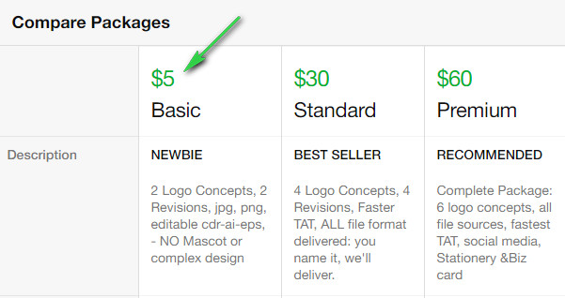
Project introduction
Fiverr has the unique thing that orders will start at $ 5, which sounds good to buyers because it is so cheap. However, I emphasize that it is the "starting price", meaning the seller can sell more upsell and cross-sale packages of that service. For example :

Slide 5
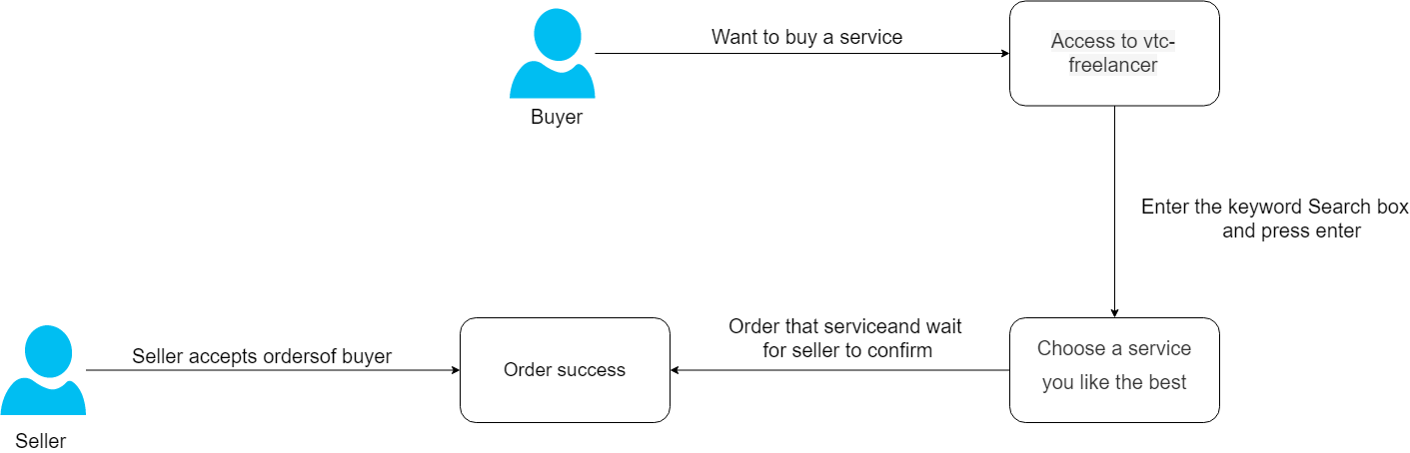
Operating model of the system
For service buyers (Buyer)
For service providers (Seller)

Slide 6
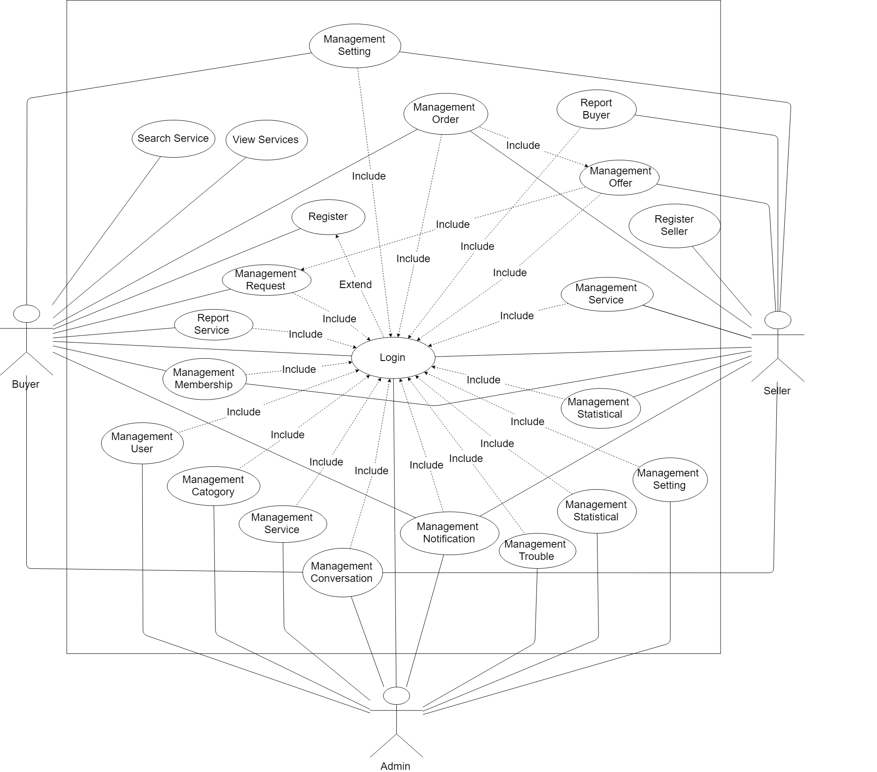
Use Case
Use case diagram

Slide 7
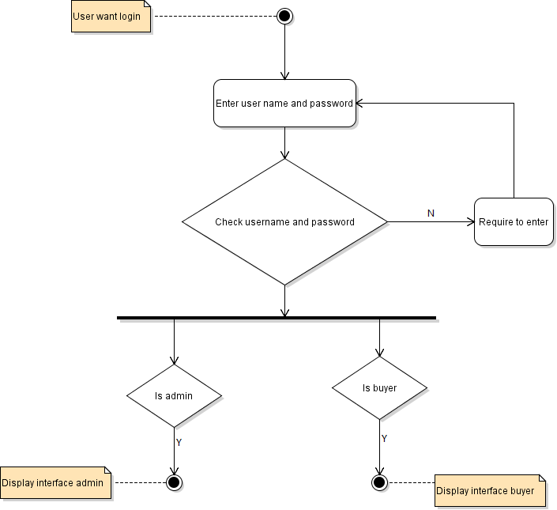
Activity Diagram
Login

Slide 8
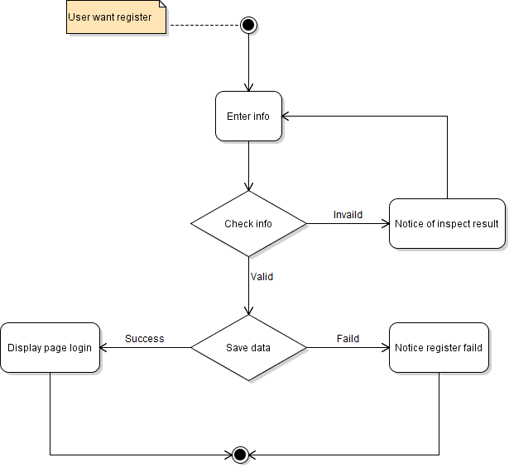
Activity Diagram
Register

Slide 9
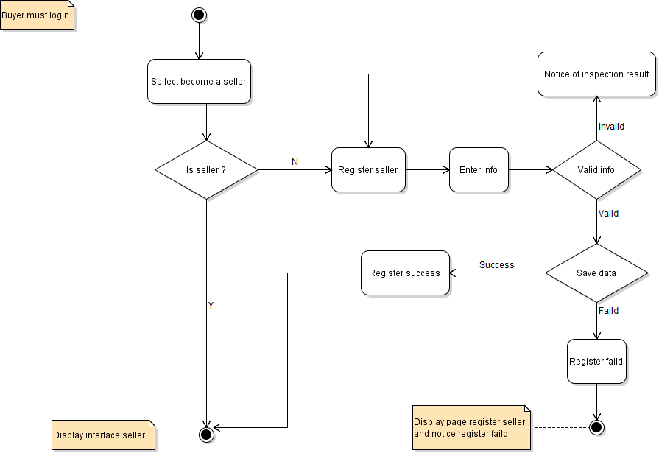
Activity Diagram
Register seller

Slide 10
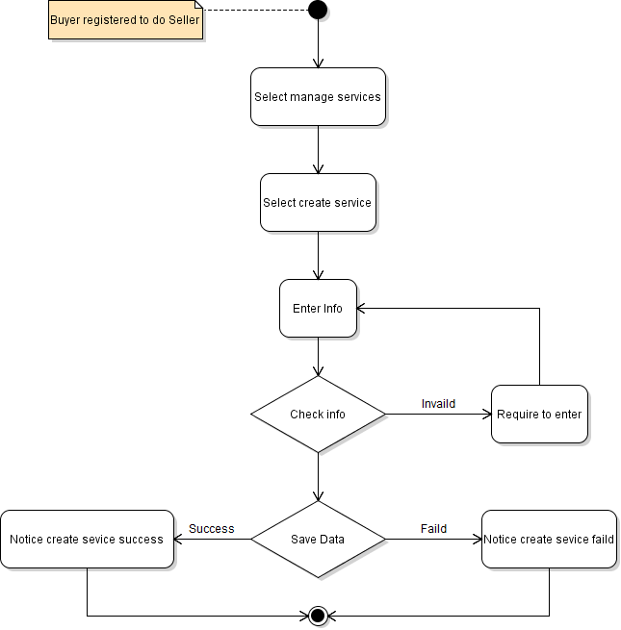
Activity Diagram
Create service

Slide 11
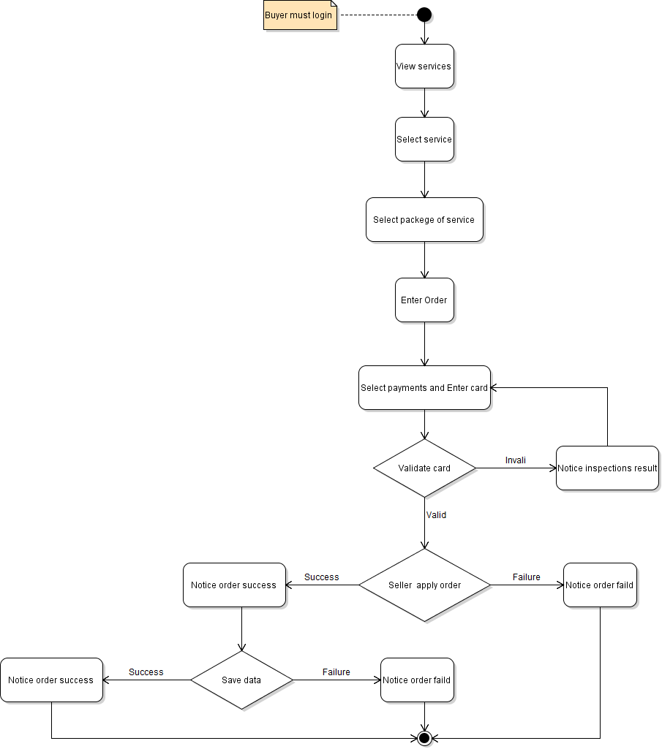
Activity Diagram
Create order

Slide 12
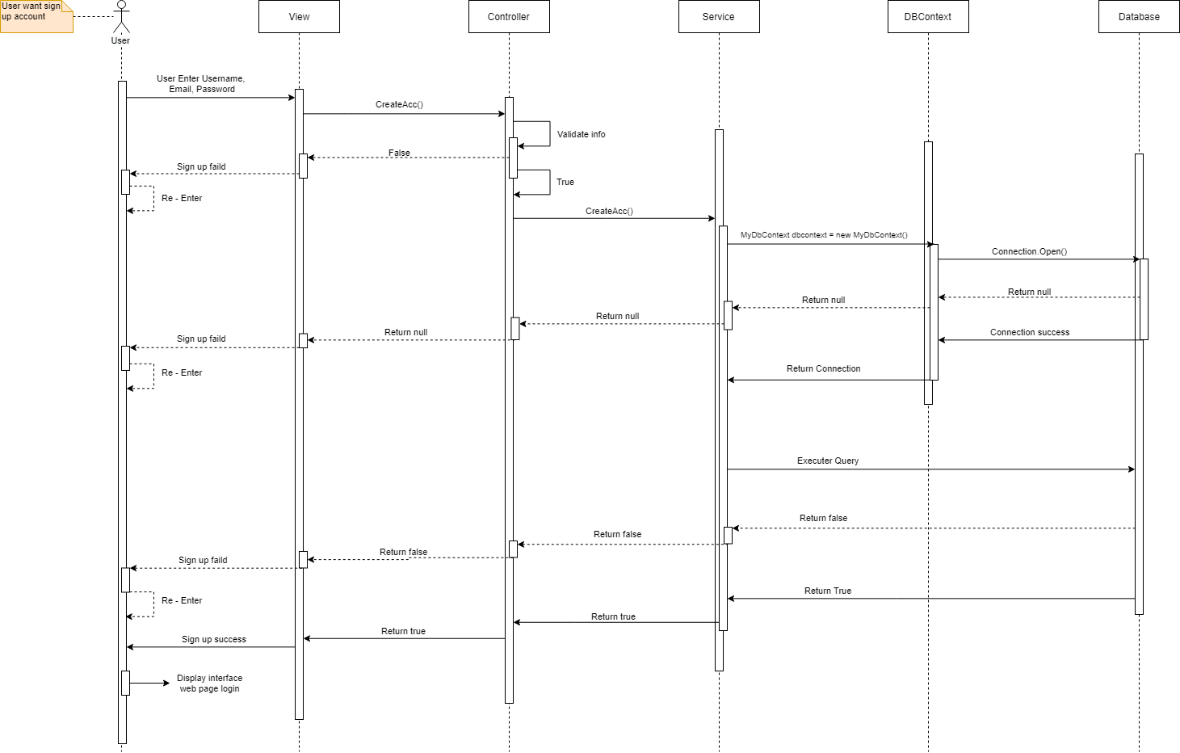
Sequense Diagram
Register

Slide 13
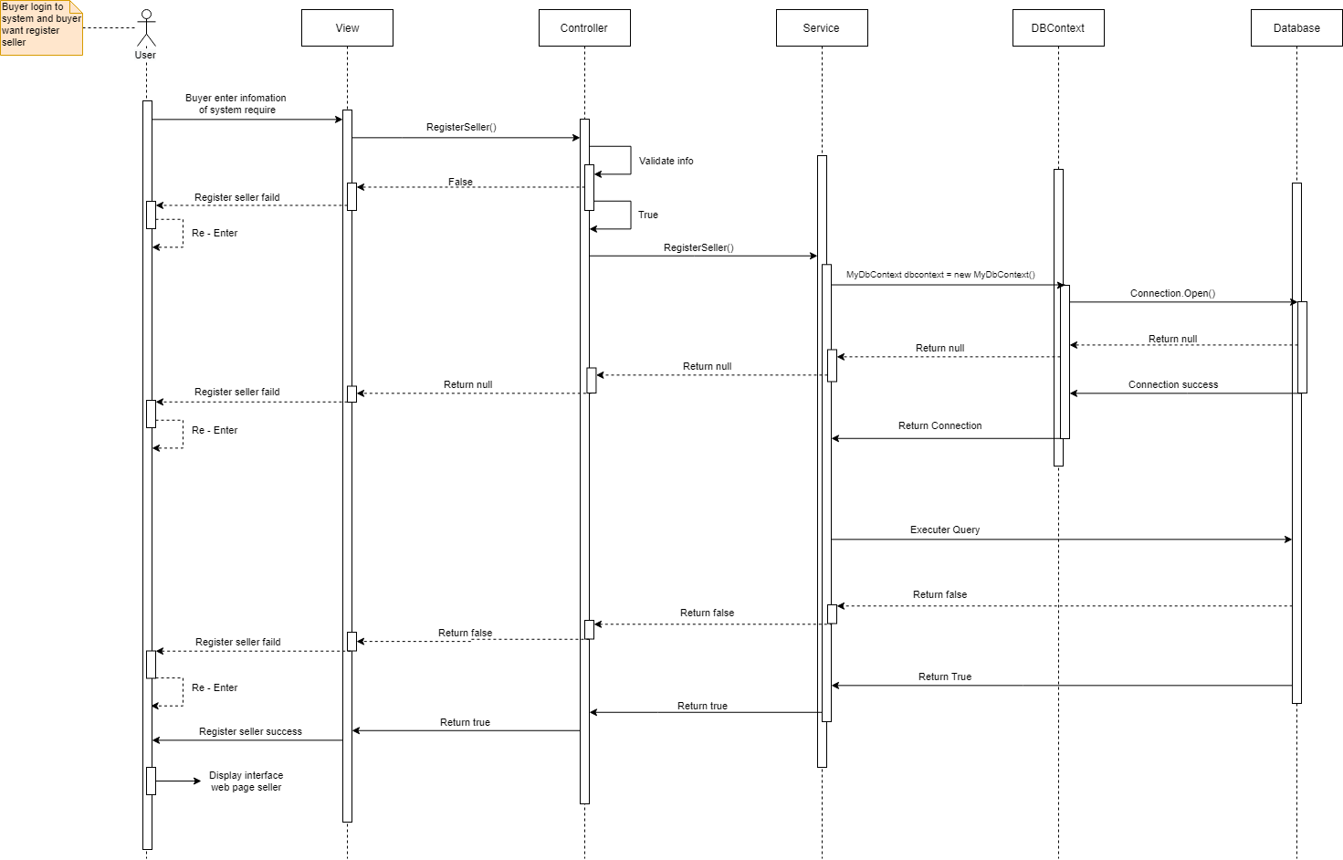
Sequense Diagram
Register Seller

Slide 14
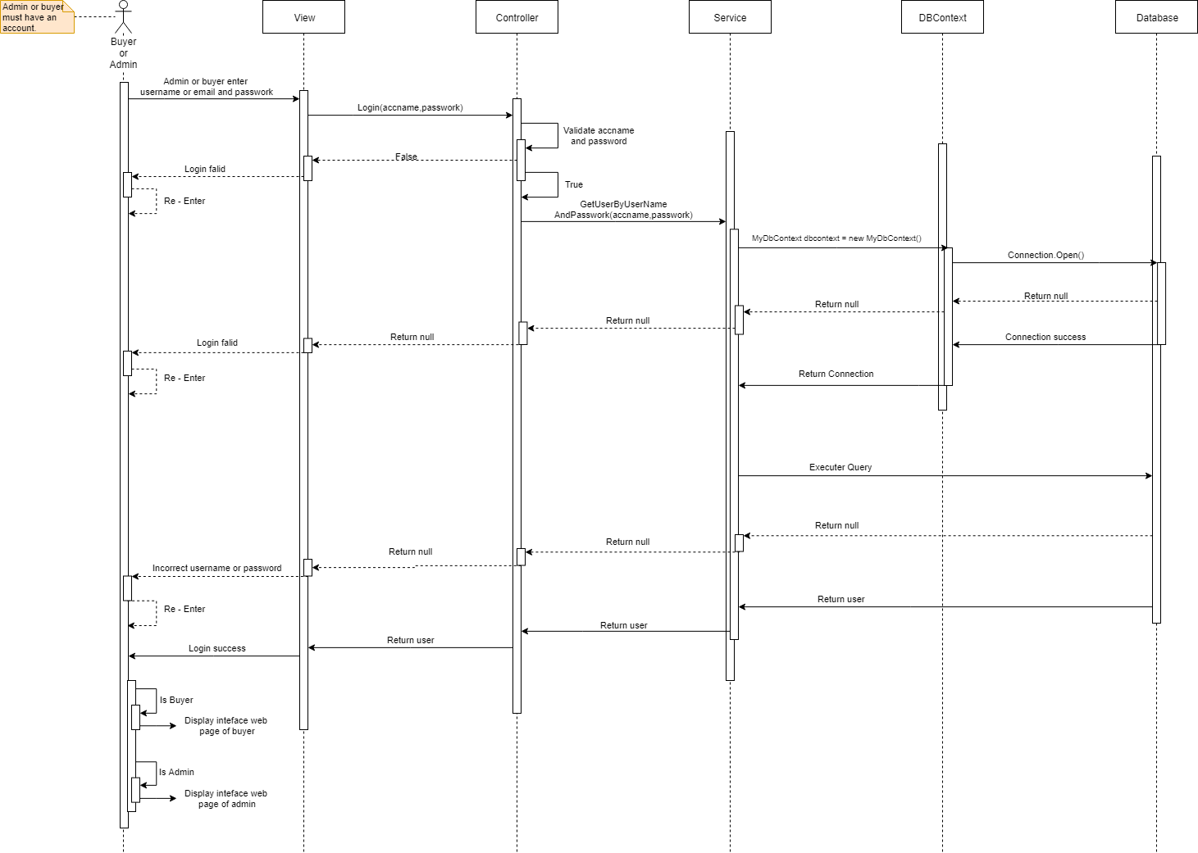
Sequense Diagram
Login

Slide 15
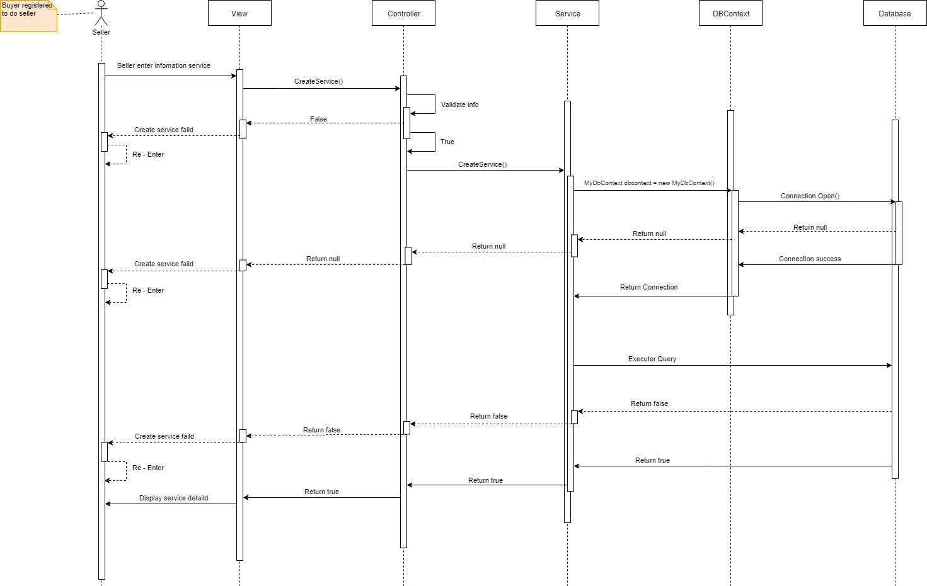
Sequense Diagram
Create service

Slide 16
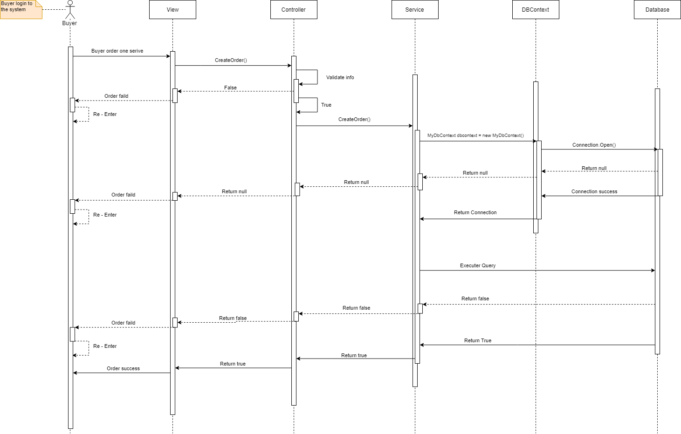
Sequense Diagram
Create service

Slide 17
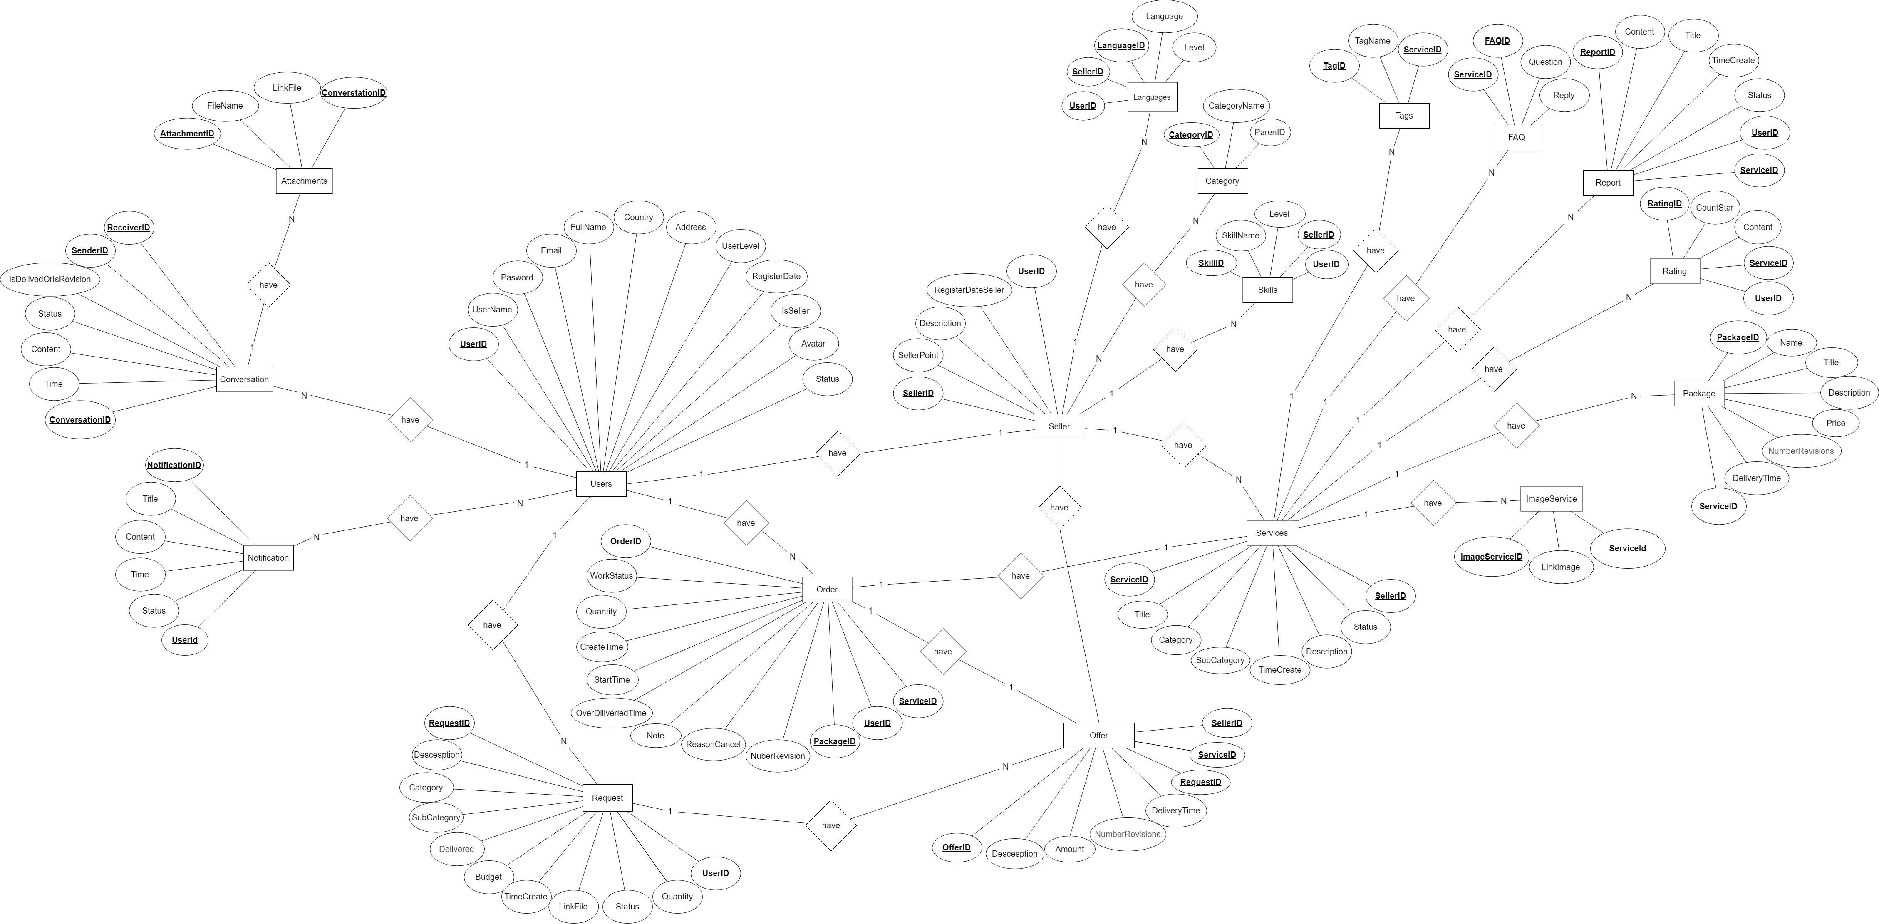
ERD Diagram
Mô hình ERD

Slide 18
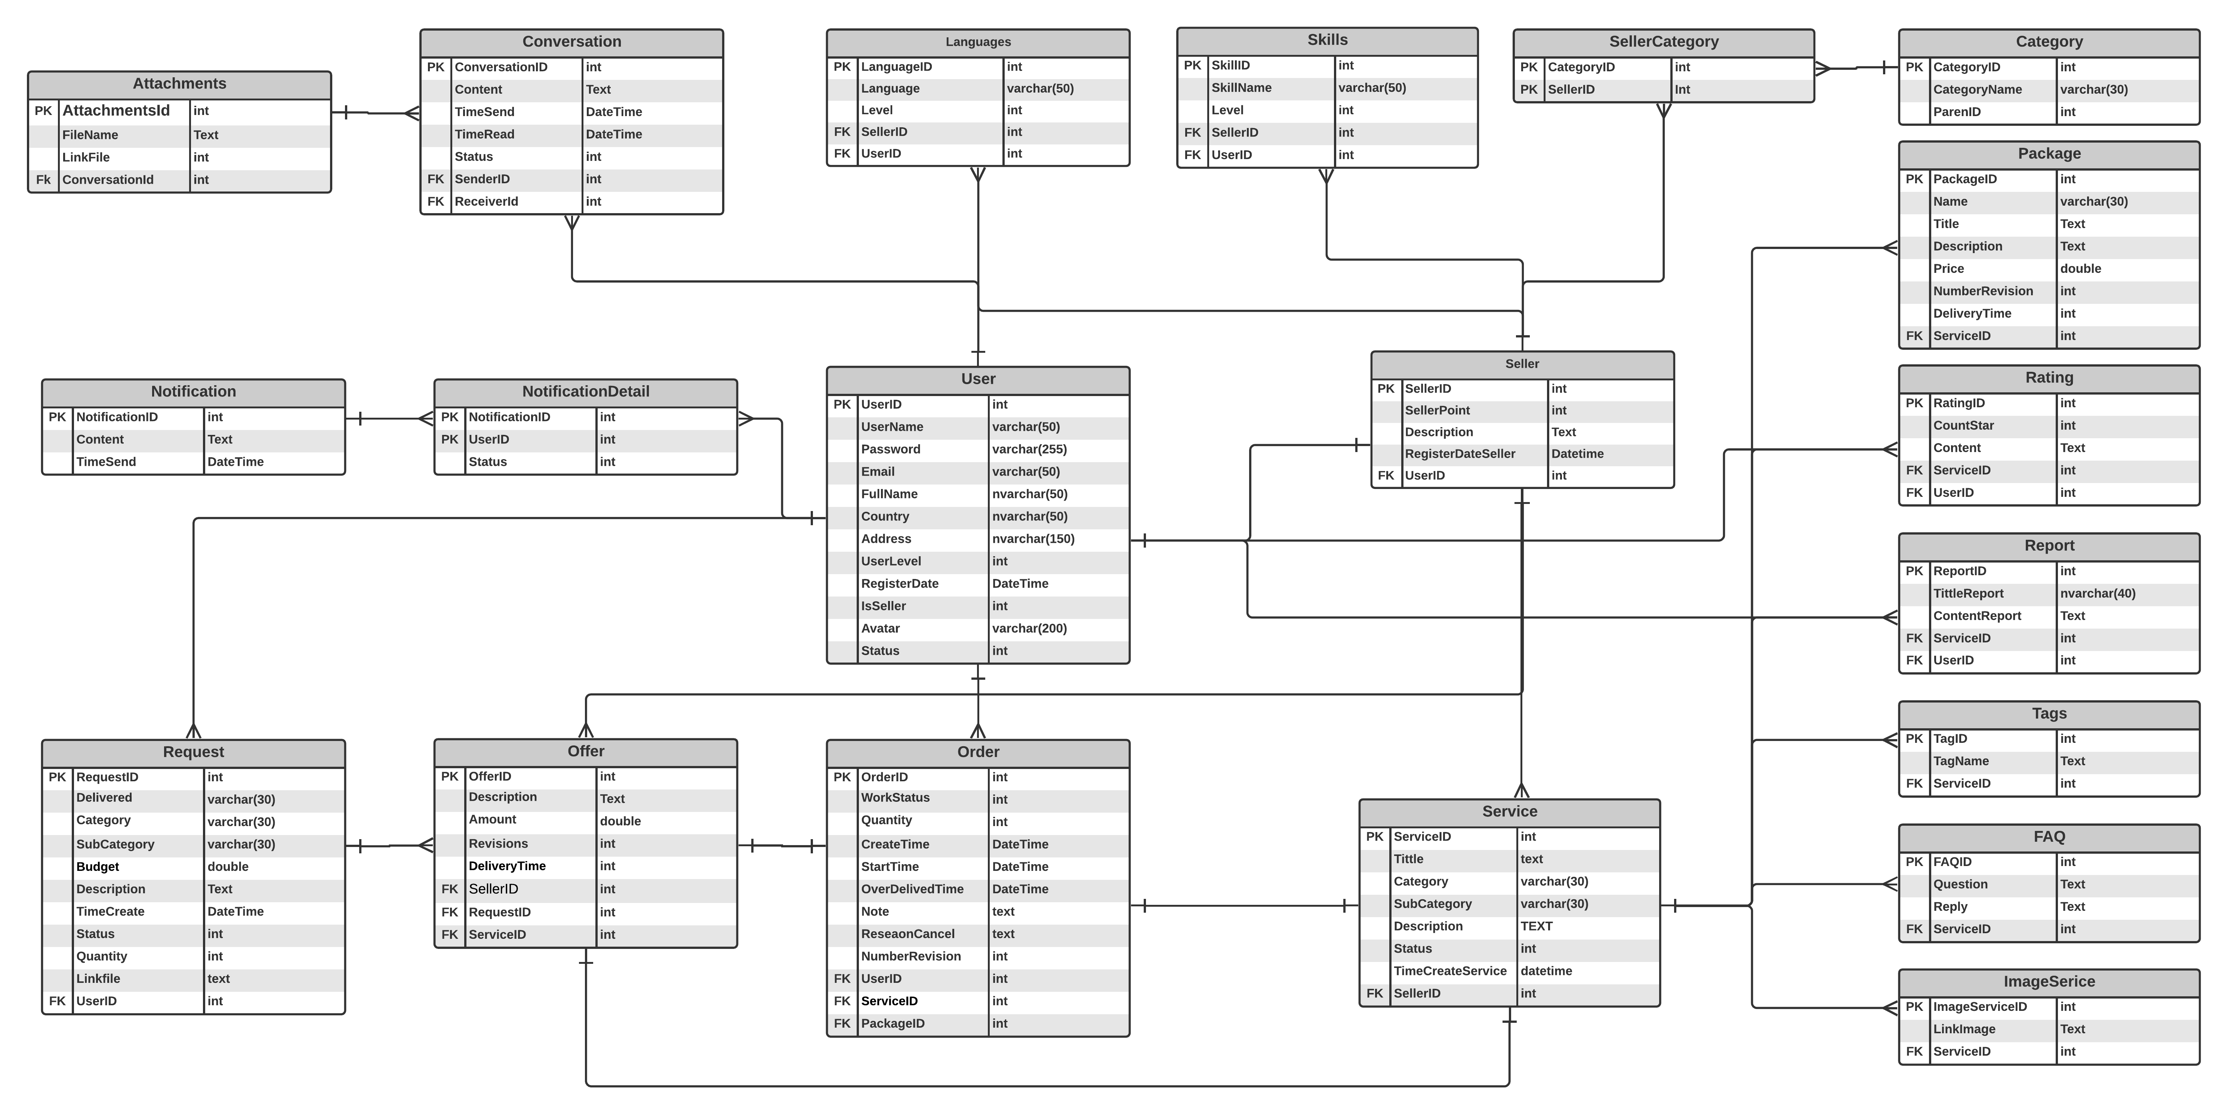
Database diagram
Database diagram

Slide 19
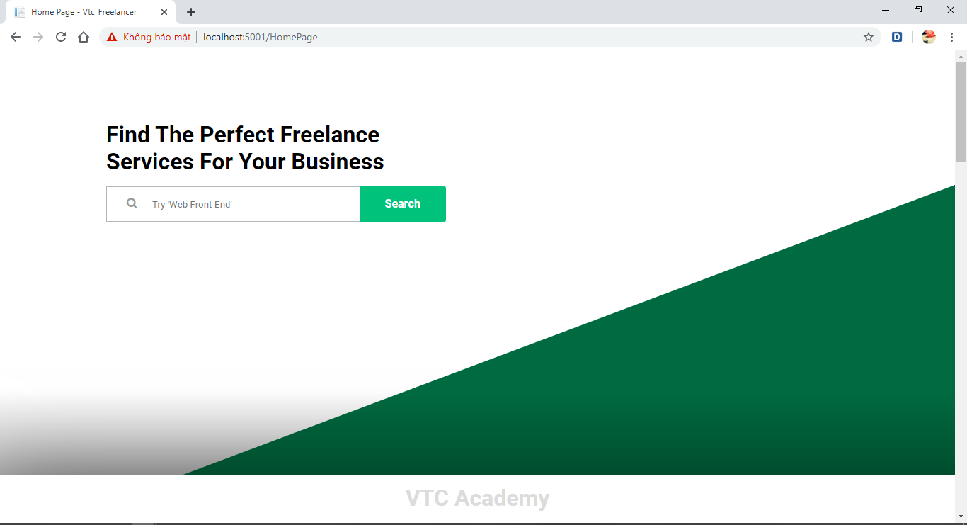
UI

Slide 20
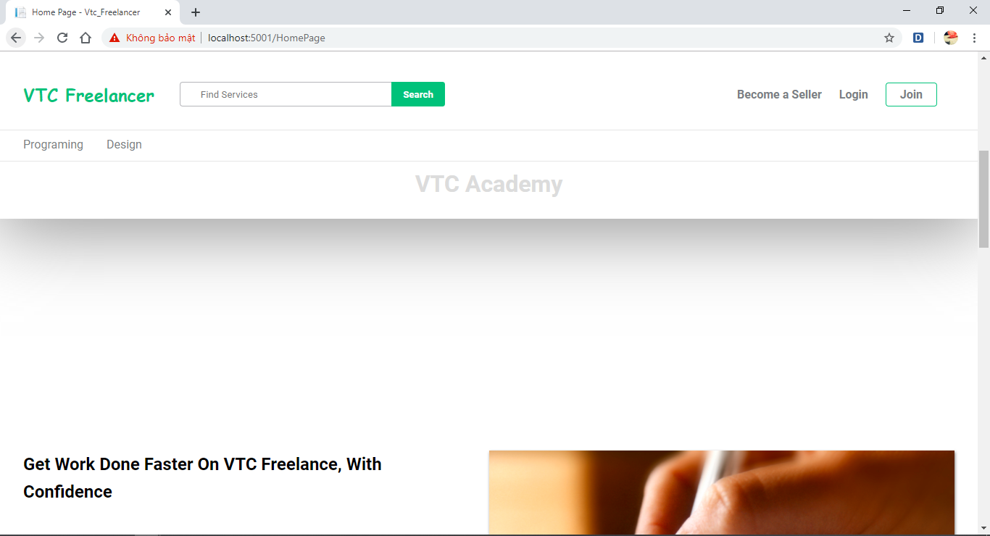
UI

Slide 21
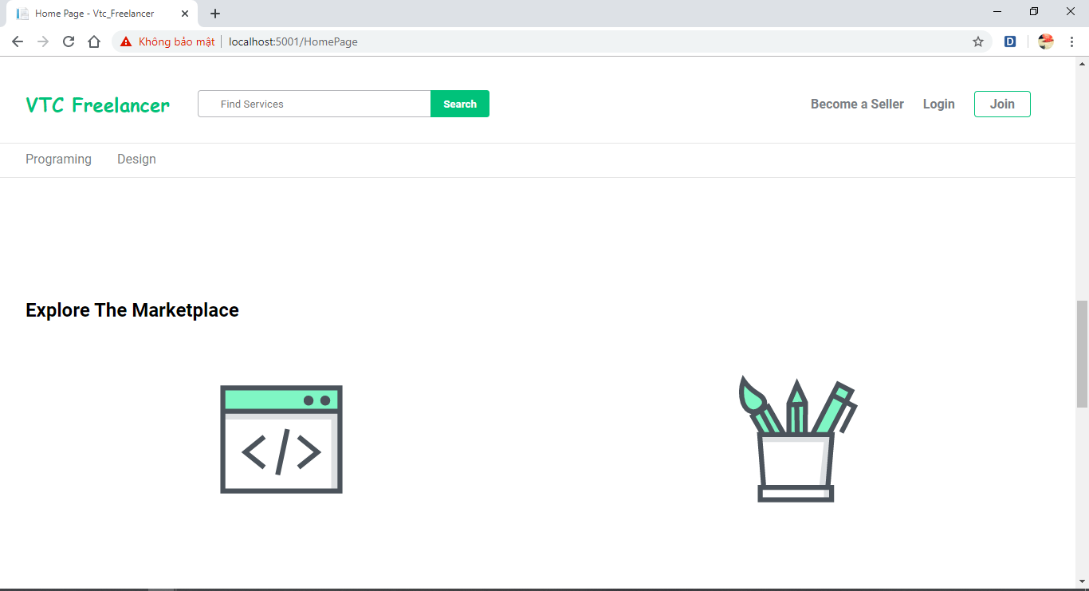
UI

Slide 22
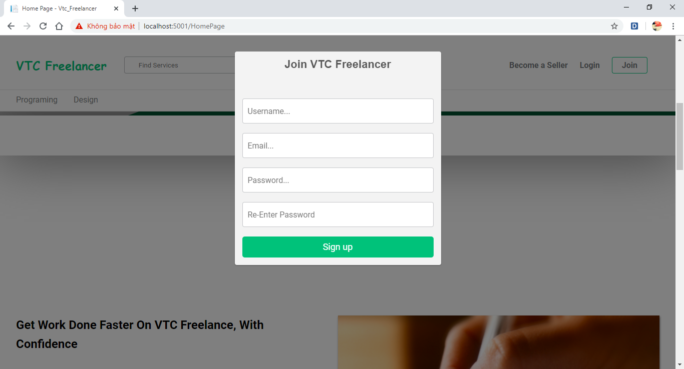
UI

Slide 23
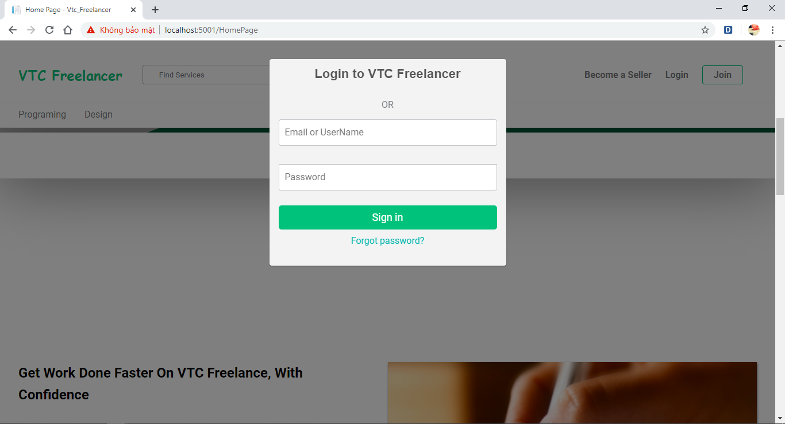
UI

Slide 24
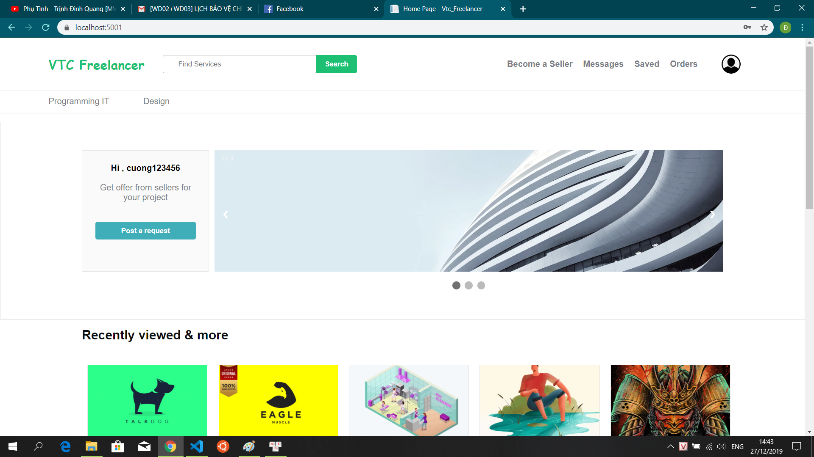
UI

Slide 25
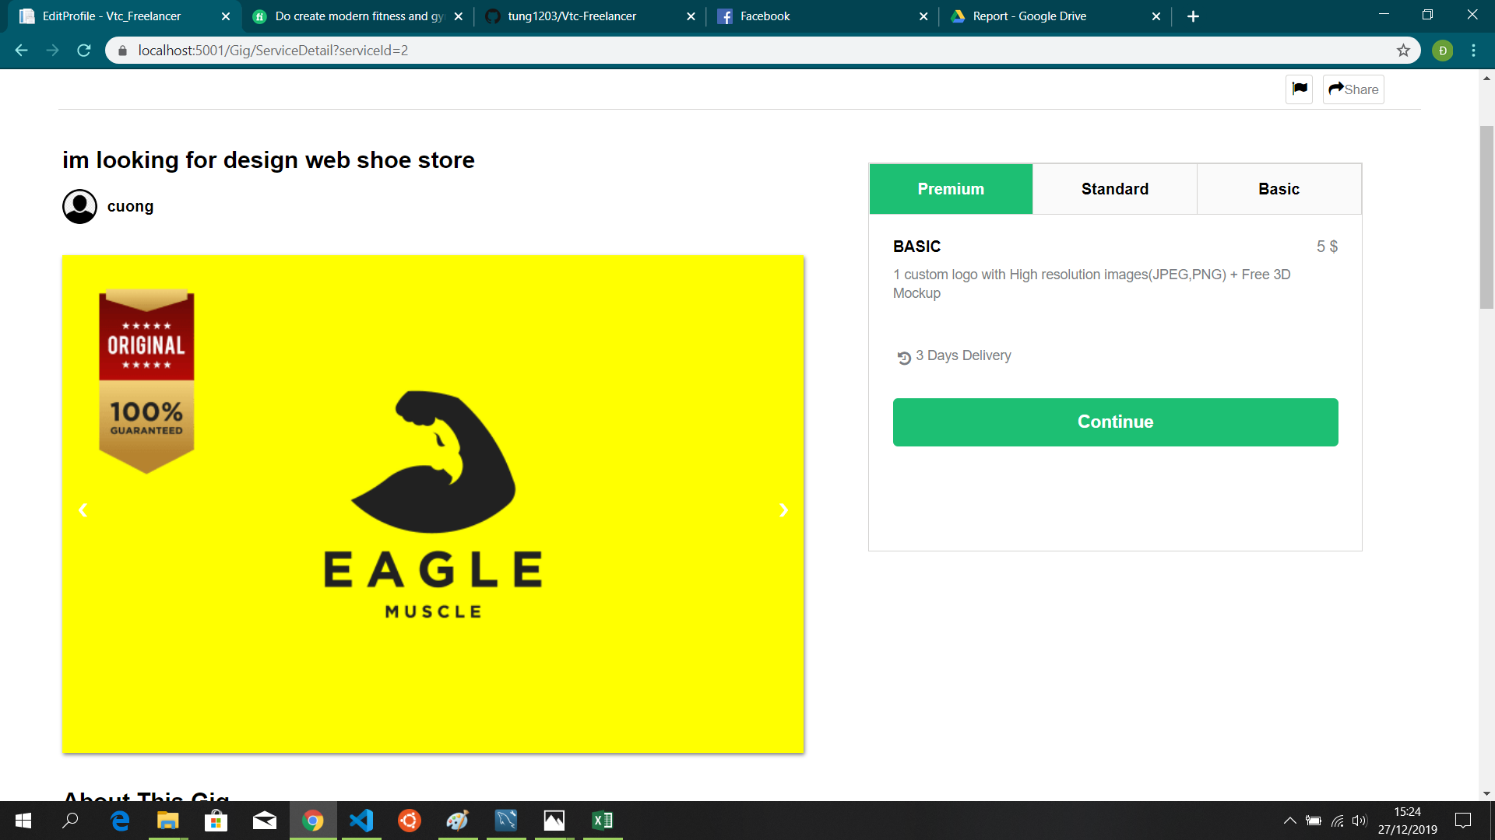
UI

Slide 26
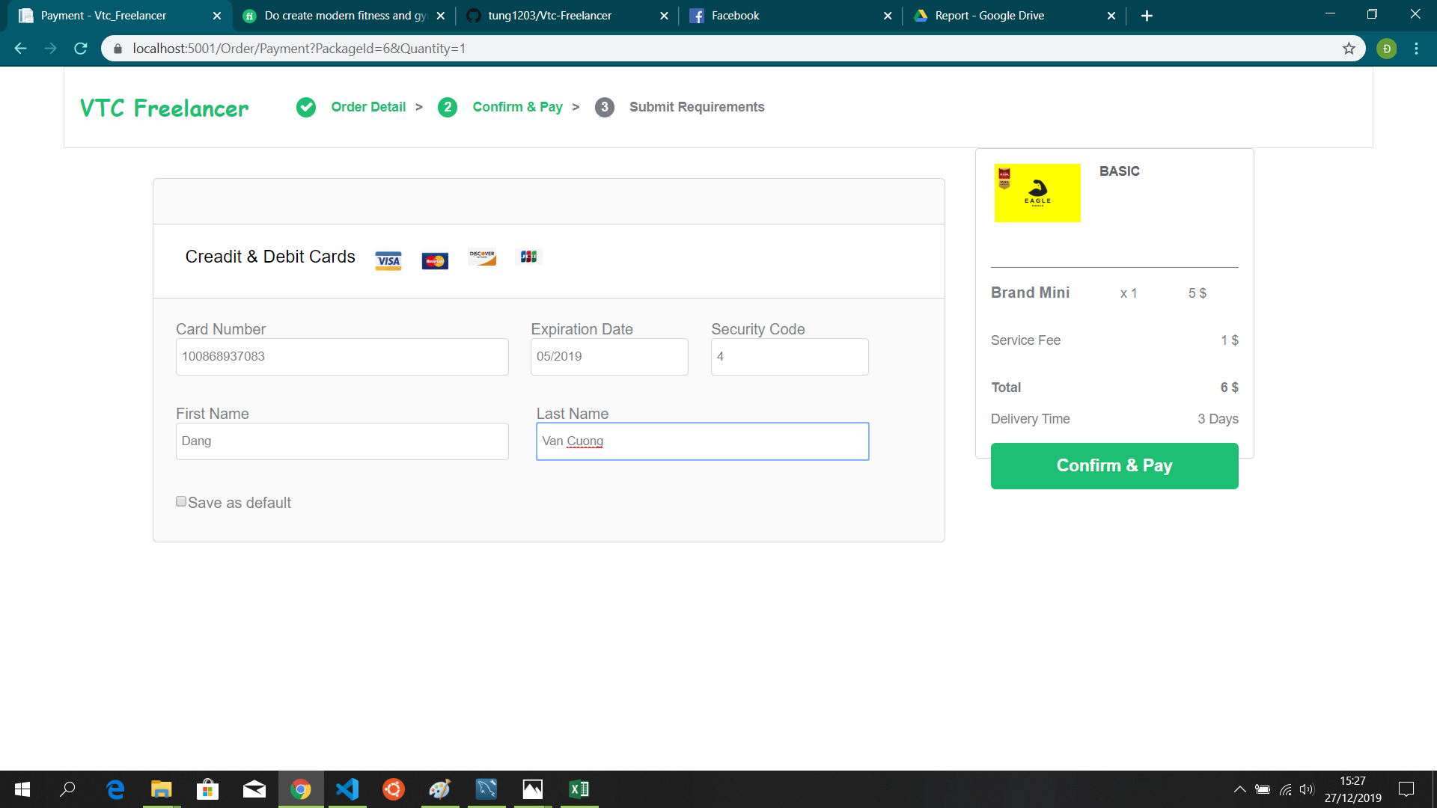
UI

Slide 27
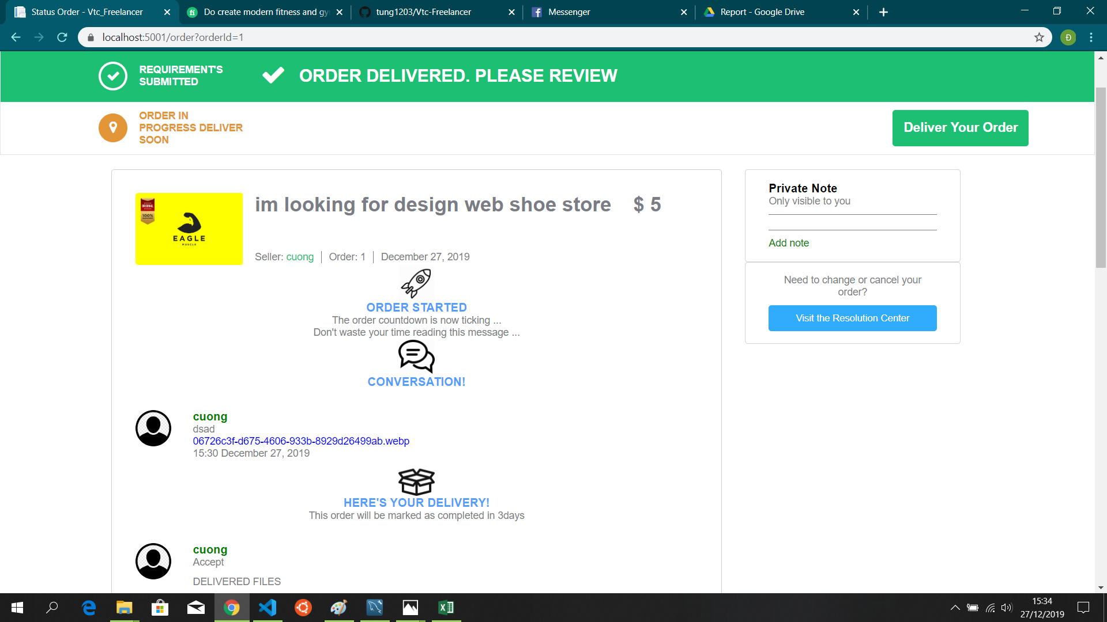
UI

Slide 28
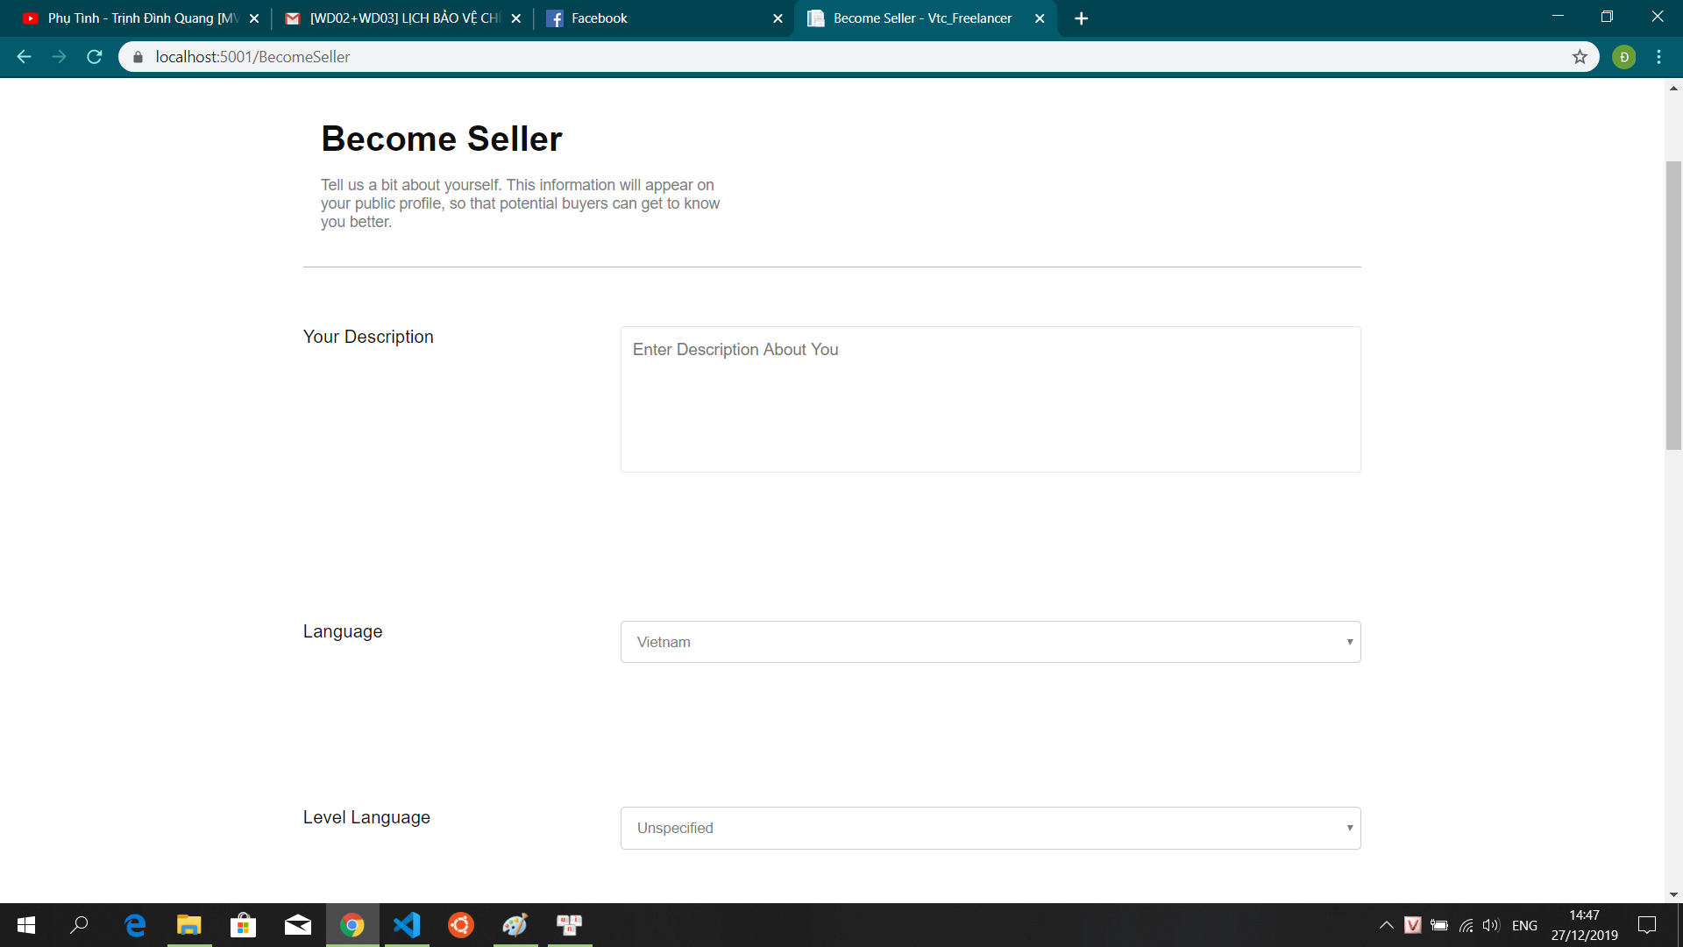
UI

Slide 29
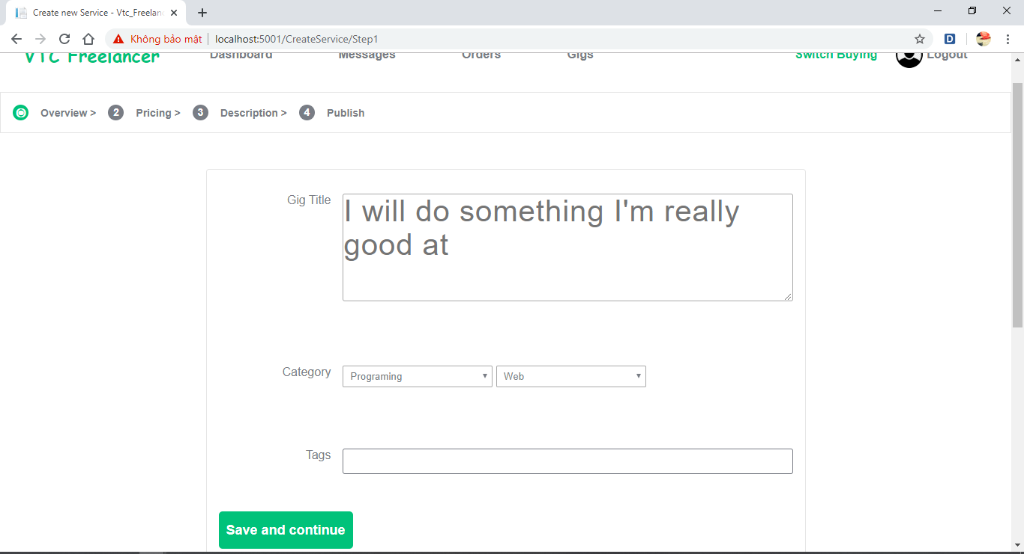
UI

Slide 30
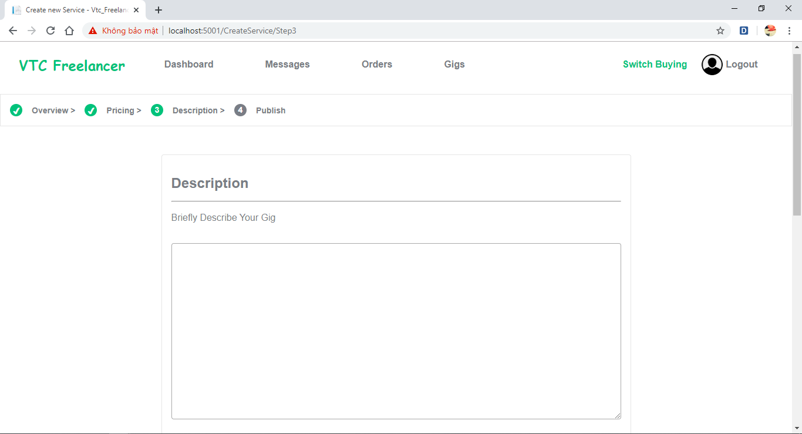
UI

Slide 31
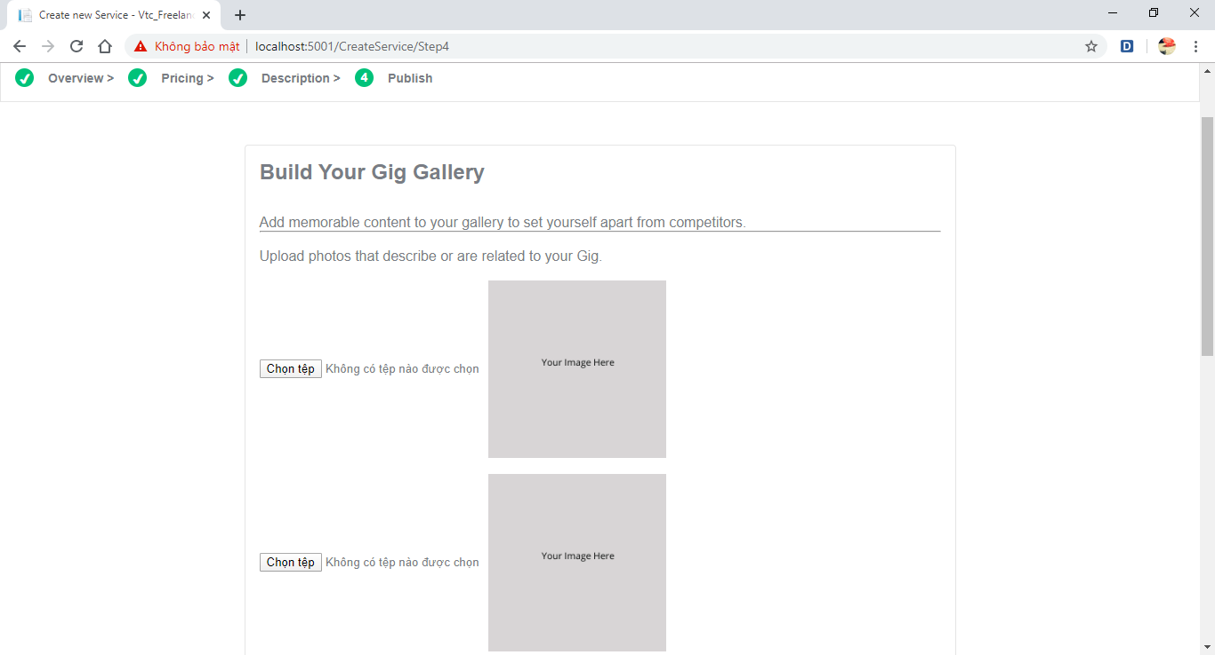
UI

Slide 32
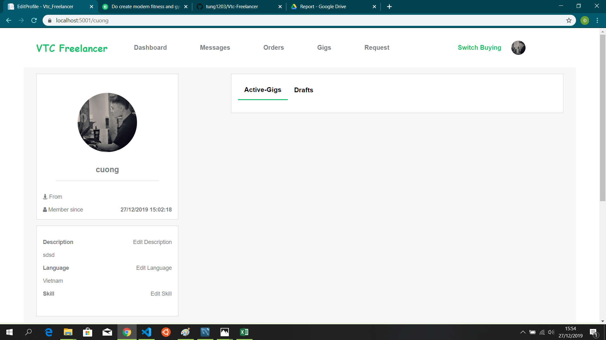
UI

Slide 33
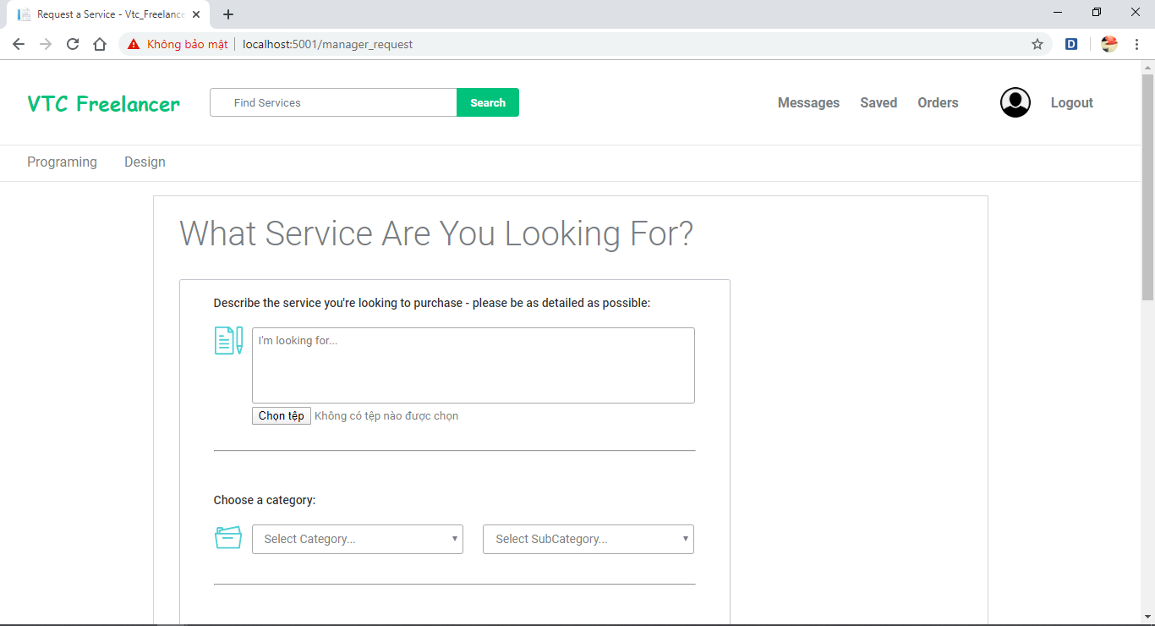
UI

Slide 34
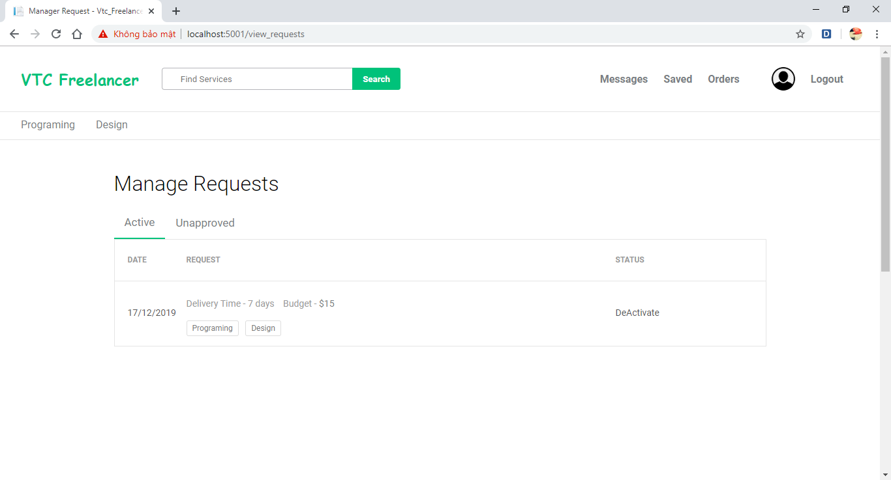
UI

Slide 35
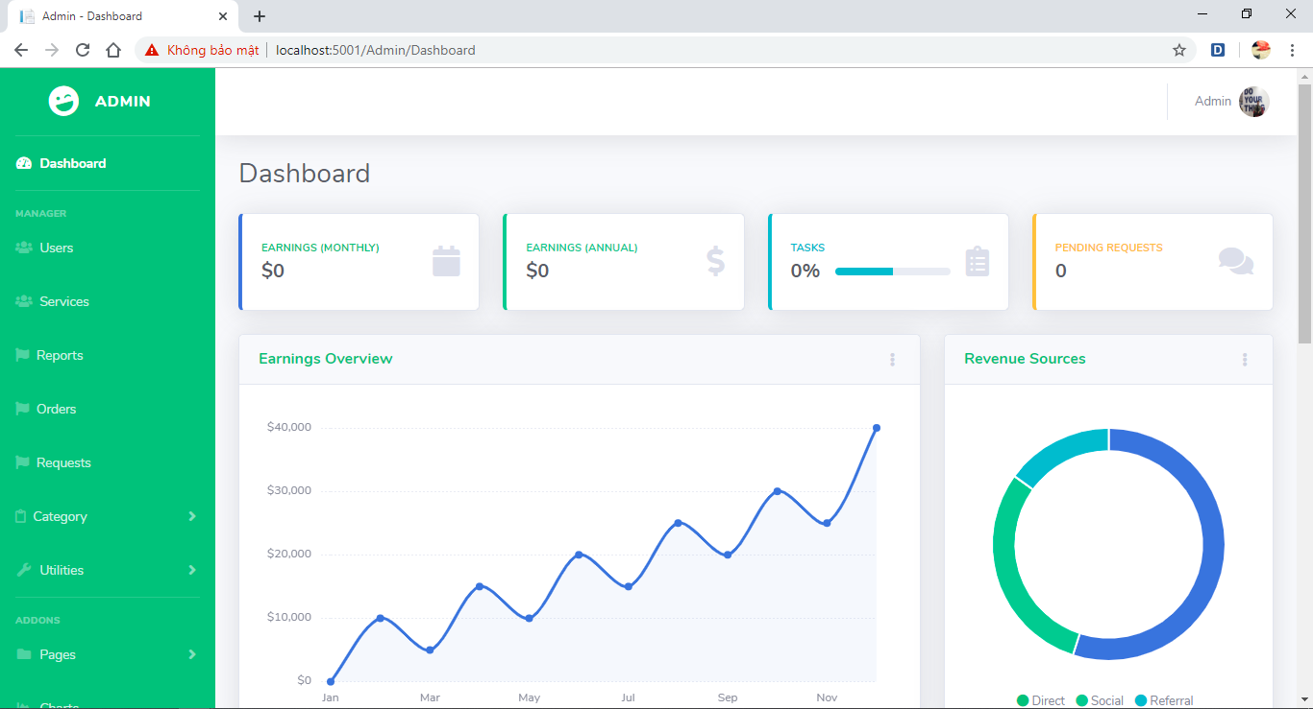
UI

Slide 36
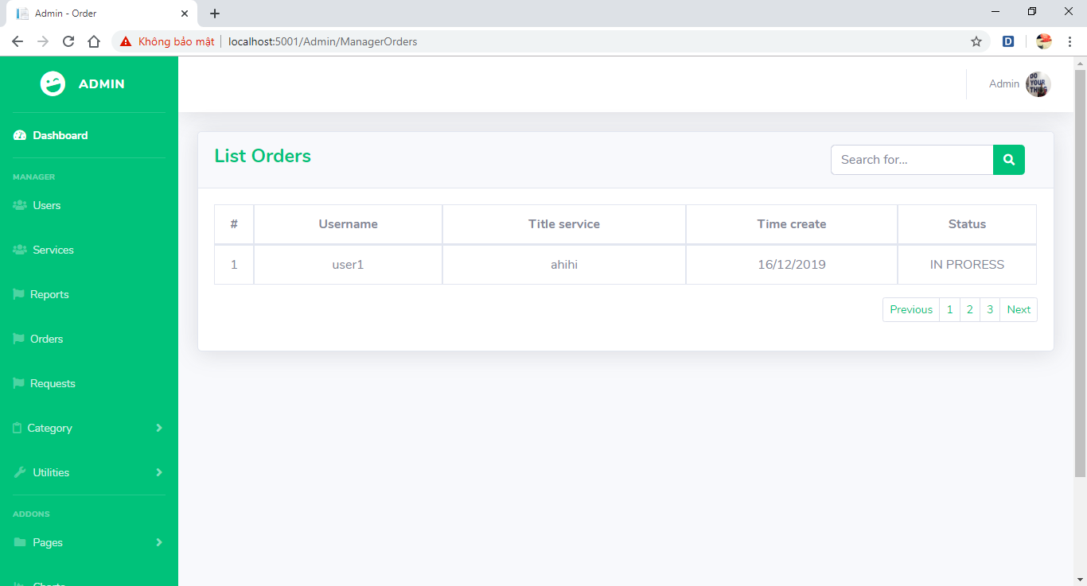
UI

Slide 37
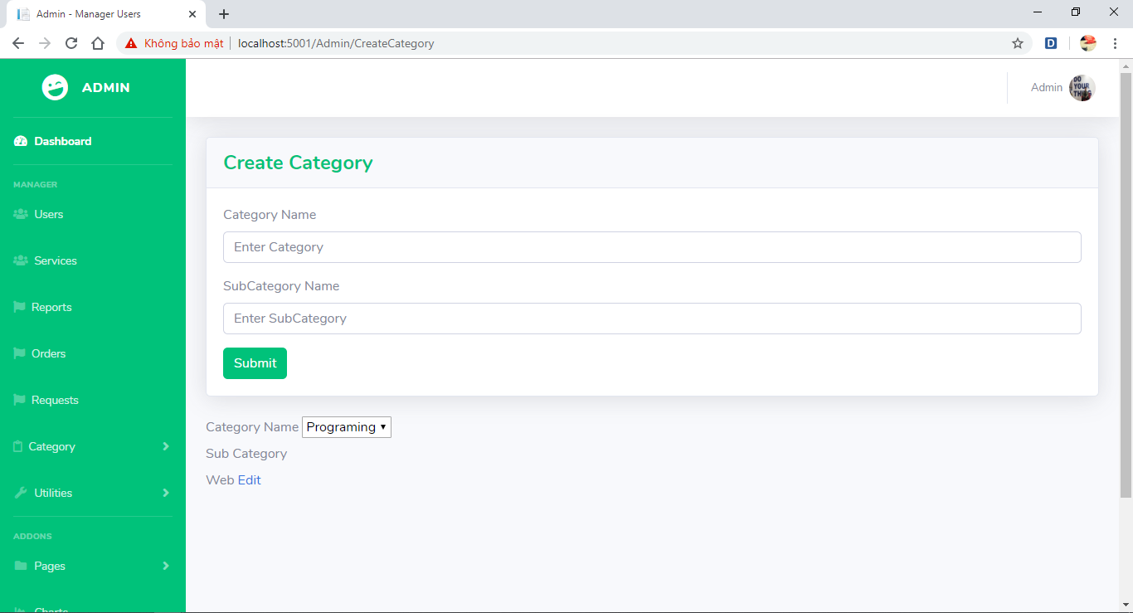
UI

Slide 38
References
https://www.w3schools.com/
https://www.fiverr.com/
https://stackoverflow.com/

Slide 39
Summary
Used for development
- Programming language : C#.
- Database : Mysql
- Technology: ASP .net core 3.0
- Reporting tools : Microsoft Word
- Development tools : Visual Studio Code, Violet UML, Mysql Workbench, Lucidchart, draw.io.
Result
- Learn the process of making a web application
- Learn how to assign team work
- Analysis of problem solving in a login way
- Limit
- Haven't solved the whole problem
- Still limited in knowledge
- Not good teamwork

Slide 40
Q & A

